Slide 1
00 — Navigating the Shortest Path Between Cities
Algorithms that turn complex road networks into fast, reliable routes. From theory to production: how we compute, optimize, and present the best path for drivers, walkers, and multimodal travelers.

Slide 2
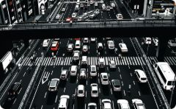
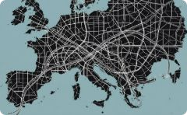

Why Finding the Shortest Path Matters
Save time & fuel
Efficient routes reduce travel time, fuel consumption, and CO2 emissions.
Scale & reliability
Navigation must work across millions of trips on ever-changing networks.
Economic impact
Faster deliveries, better fleet utilization, and lower operational cost.

Slide 3

The Shortest Path Problem in Graph Theory
Model roads as a graph: nodes = intersections/cities, edges = roads with weights (distance, time, toll). The objective: compute a path from source to destination minimizing the sum of weights.
Weights
Distance, travel time, cost, or composite score.
Constraints
One-way streets, closures, vehicle restrictions.
Scale
City to continent—algorit hm choice depends on graph size.

Slide 4
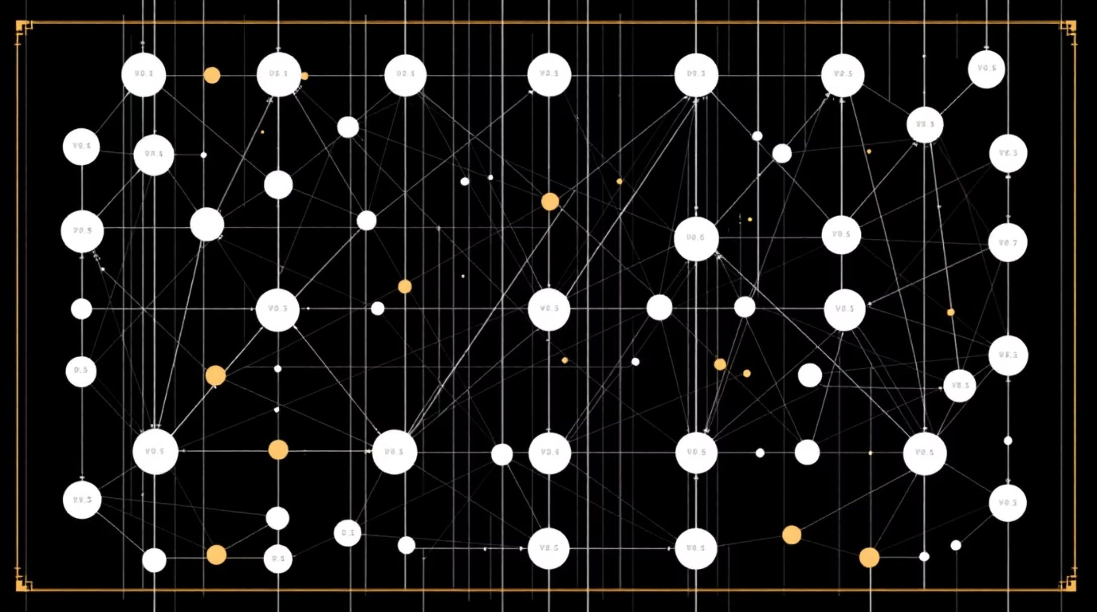
Dijkstra’s Algorithm: The Classic
D^{W}ijksºtr^{r}a (^{k}19^{h}56º) fi^{r}nd^{s}s^{e}shortest paths from one source to every reachable node for non-negative weights. It expands the nearest unvisited node greedily, updating tentative distances until all shortest paths are settled.
Why it’s useful
Simple, robust, deterministic
Works with weighted edges (non-negative)
Building block for more advanced routing techniques

Slide 5

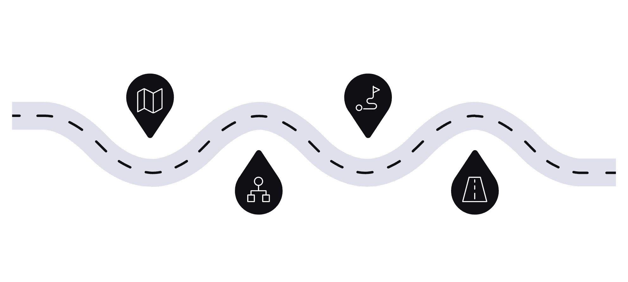




Visualizing Dijkstra’s Algorithm
Watch the shortest-path tree grow from the source. Distances are
relaxed as nearer nodes are finalized; edges switch from tentative to final. This stepwise update explains why Dijkstra is predictable and traceable.
Source
Start node with distance 0
Expansion 2 Finalize closer nodes and update
Expansion 1 Relax neighbors and mark tentative
Final Path Shortest path highlighted to target
Diagram: expansion sequence and final shortest-path highlight to
illustrate dynamic updates.

Slide 6




Scaling Up: Contraction Hierarchies
Real-world routing demands sub-second queries on continental maps. Contraction Hierarchies (CH) preprocess the graph by
contracting low-importance nodes and adding shortcut edges so queries traverse a compact hierarchy.
Fast queries
Average query time drops to milliseconds after preprocessing.
Preprocessing cost
Significant oﬄine work—traded for ultra-fast online queries.
Production use
Used by major navigation providers for continental routing.

Slide 7


Beyond Cars: Pedestrian Navigation Challenges
Pedestrian routing is richer than shortest distance: accessibility, safety, sidewalk quality, elevation, and comfort matter. Pure shortest-paths can be unsuitable for people with mobility needs.
Accessibility-aware routing
Penalty weights for stairs, prefer ramps and lifts.
Comfort & safety
Tradeoff distance for well-lit, wide sidewalks and crossings.

Slide 8

Human Navigation vs Algorithmic Paths
Humans favor routes that are easy to remember and orient: direct-feeling lines, visible landmarks, and simple turns.
Algorithms that incorporate landmark-based scoring and cognitive preferences produce routes people prefer—even if slightly longer.
Orientation
Routes with clear landmarks reduce perceived complexity.
Preference modeling
Personalization (scenic, fastest, easiest) increases adoption.

Slide 9
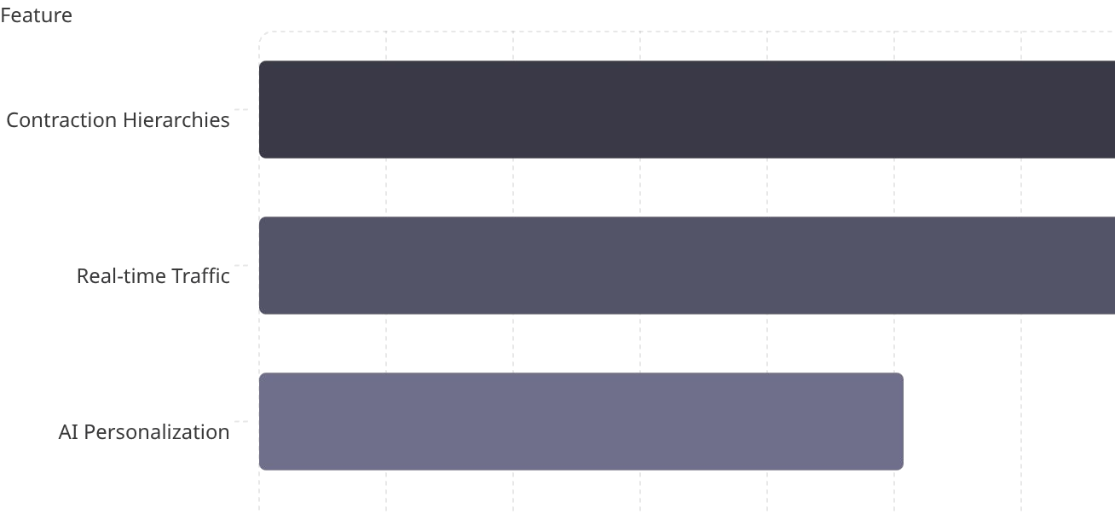
Real-World Impact & Innovations
Modern systems combine CH, real-time traffic, and dynamic re-routing. Emerging layers include AI for personalized routing, multimodal trip assembly (bike, transit, walk), and pedestrian-specific optimization for cities like Thessaloniki.
Bar chart: relative impact of technologies improving routing speed, accuracy, and user satisfaction.

Slide 10

The Road Ahead
Smarter
AI and behavioral models tailor routes to people, not just metrics.
Faster
Improved preprocessing and hybrid algorithms cut query times further.
More human
Designing routes that feel natural—balancing efficiency with comfort and accessibility.
Goal: seamless, personalized navigation that saves time, energy, and improves travel experience for everyone. Let’s navigate smarter—together.

